Slide 1

Digital Image Processing
Dr. Mubashir Ahmad (Ph.D.)

Slide 2
What is a Digital Image Processing?
The main objective of image processing is to transform an image into digital form and perform certain operations on it in order to obtain specific models or to extract useful information from the image.
An image may be defined as a two-dimensional function, f (x ,y ), where x and y are spatial (plane) coordinates, and the amplitude of f at any pair of coordinates (x , y ) is called the intensity or gray level of the image at that point. When x, y, and the intensity values of f are all finite, discrete quantities, we call the image a digital image.
The field of digital image processing refers to processing digital images by means of a digital computer. Note that a digital image is composed of a finite number of elements, each of which has a particular location and value. These elements are called picture elements, image elements, and pixels.

Slide 3
What is a Digital Image Processing?
There are no clear-cut boundaries in the continuum from image processing at one end to computer vision at the other. However, one useful paradigm is to consider three types of computerized processes in this continuum: low-, mid-, and high level processes.
Low-level processes involve primitive operations such as image preprocessing to reduce noise, contrast enhancement, and image sharpening. A low level process is characterized by the fact that both its inputs and outputs are images.
Mid-level processing of images involves tasks such as segmentation (partitioning an image into regions or objects), description of those objects to reduce them to a form suitable for computer processing, and classification (recognition) of individual objects. A mid-level process is characterized by the fact that its inputs generally are images, but its outputs are attributes extracted from those images (e.g., edges, contours, and the identity of individual objects).

Slide 4
What is a Digital Image Processing?
Finally, higher-level processing involves “making sense” of an ensemble of recognized objects, as in image analysis, and, at the far end of the continuum, performing the cognitive functions normally associated with human vision.

Slide 5
What is DIP? (cont…)
The continuum from image processing to computer vision can be broken up into low-, mid- and high-level processes
Low Level Process
Mid Level Process
High Level Process
Input: Image Output: Image
Examples: Noise removal, image sharpening
Input: Image Output: Attributes
Examples: Object recognition, segmentation
Input: Attributes Output: Understanding
Examples: Scene understanding etc
Notes:
Give the analogy of the character recognition system.
Low Level: Cleaning up the image of some text
Mid level: Segmenting the text from the background and recognising individual characters
High level: Understanding what the text says

Slide 6
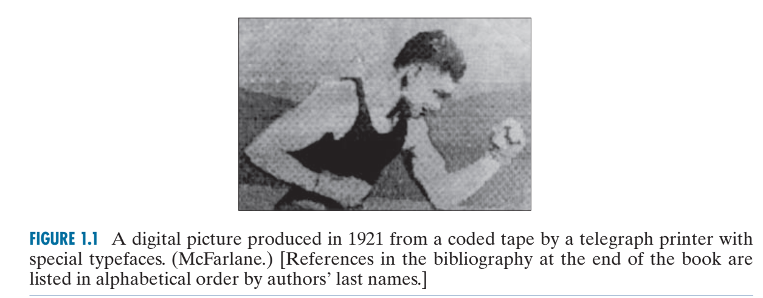
Origin of Digital Image Processing?
One of the earliest applications of digital images was in the newspaper industry, when pictures were first sent by submarine cable between London and New York. Introduction of the Bartlane cable picture transmission system in the early 1920s reduced the time required to transport a picture across the Atlantic from more than a week to less than three hours.

Slide 7
Applications of DIP
In parallel with space applications, digital image processing techniques began in the late 1960s and early 1970s to be used in medical imaging, remote Earth resources observations, and astronomy. The invention in the early 1970s of computerized axial tomography (CAT), also called computerized tomography (CT) for short, is one of the most important events in the application of image processing in medical diagnosis.
Tomography consists of algorithms that use the sensed data to construct an image that represents a “slice” through the object. Motion of the object in a direction perpendicular to the ring of detectors produces a set of such slices, which constitute a three-dimensional (3-D) rendition of the inside of the object. Tomography was invented independently by Sir Godfrey N. Hounsfield and Professor Allan M. Cormack, who shared the 1979 Nobel Prize in Medicine for their invention.

Slide 8
Applications of DIP
It is interesting to note that X-rays were discovered in 1895 by Wilhelm Conrad Roentgen, for which he received the 1901 Nobel Prize for Physics. These two inventions, nearly 100 years apart, led to some of the most important applications of image processing today.
From the 1960s until the present, the field of image processing has grown vigorously. In addition to applications in medicine and the space program, digital image processing techniques are now used in a broad range of applications.
Computer procedures are used to enhance the contrast or code the intensity levels into color for easier interpretation of X-rays and other images used in industry, medicine, and the biological sciences.

Slide 9
EXAMPLES OF FIELDS THAT USE DIGITAL IMAGE PROCESSING
Geographers use the same or similar techniques to study pollution patterns from aerial and satellite imagery. Image enhancement and restoration procedures are used to process degraded images of unrecoverable objects, or experimental results too expensive to duplicate.
In archeology, image processing methods have successfully restored blurred pictures that were the only available records of rare artifacts lost or damaged after being photographed.
In physics and related fields, computer techniques routinely enhance images of experiments in areas such as high-energy plasmas and electron microscopy.
Similarly successful applications of image processing concepts can be found in astronomy, biology, nuclear medicine, law enforcement, defense, and industry

Slide 10
EXAMPLES OF FIELDS THAT USE DIGITAL IMAGE PROCESSING
The second major area of application of digital image processing techniques mentioned at the beginning of this chapter is in solving problems dealing with machine perception. In this case, interest is on procedures for extracting information from an image, in a form suitable for computer processing.

Slide 11
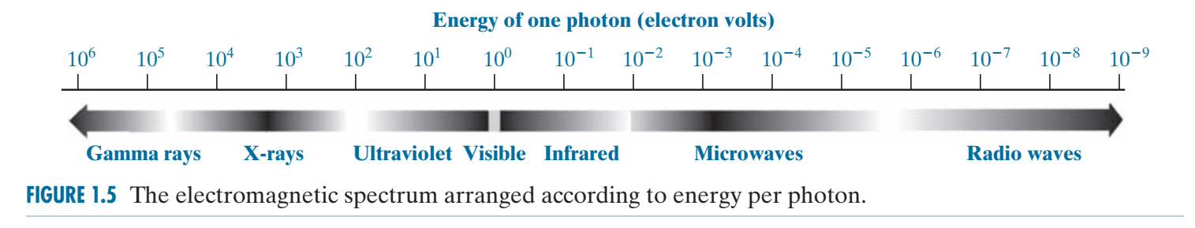
EXAMPLES OF FIELDS THAT USE DIGITAL IMAGE PROCESSING

Slide 12
GAMMA-RAY IMAGING
Major uses of imaging based on gamma rays include nuclear medicine and astronomical observations. In nuclear medicine, the approach is to inject a patient with a radioactive isotope that emits gamma rays as it decays. Images are produced from the emissions collected by gamma-ray detectors.
Images of this sort are used to locate sites of bone pathology, such as infections or tumors.
Angiography is another major application in an area called contrast enhancement radiography.
Another important use of X-rays in medical imaging is computerized axial tomography (CAT). Due to their resolution and 3-D capabilities, CAT scans revolutionized medicine from the moment they first became available in the early 1970s.

Slide 13
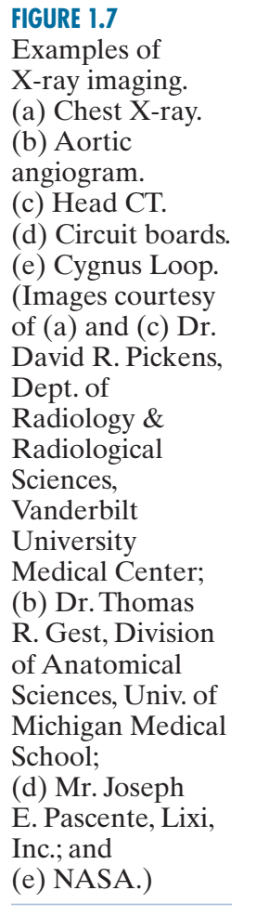
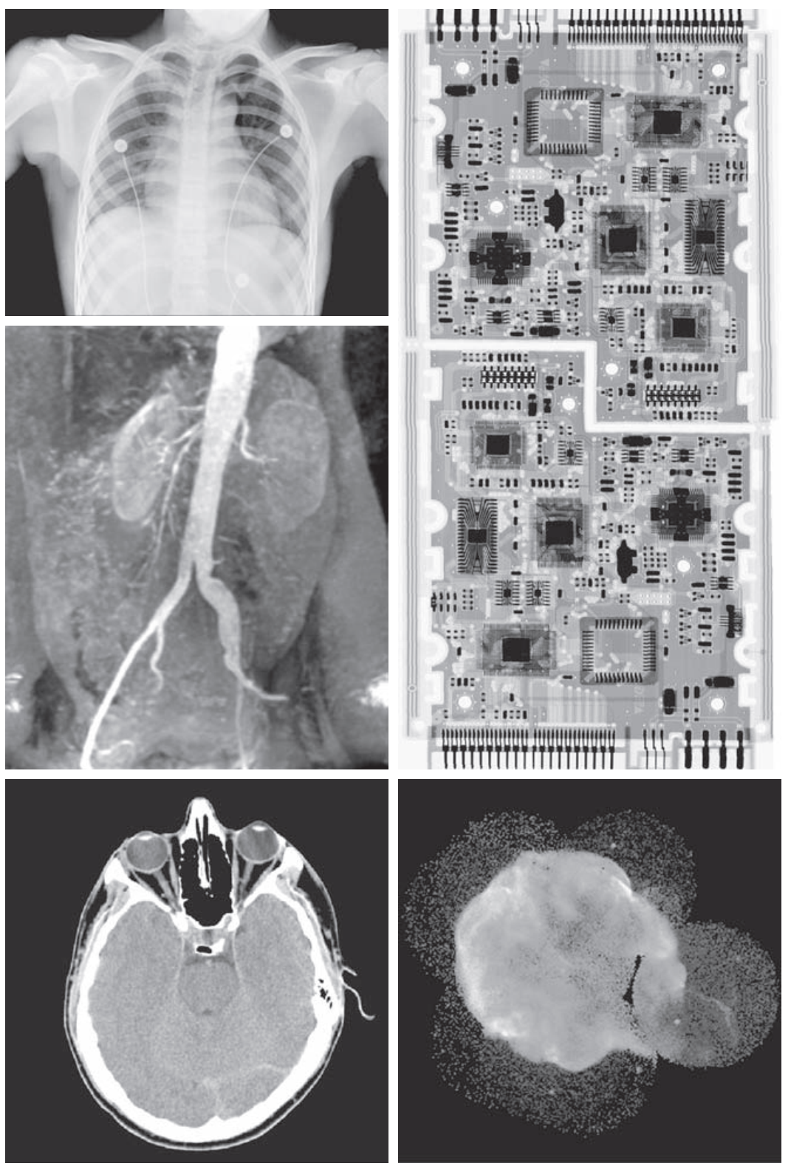
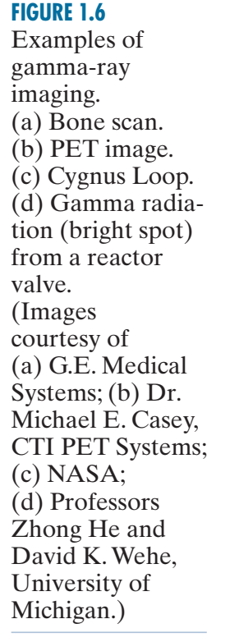
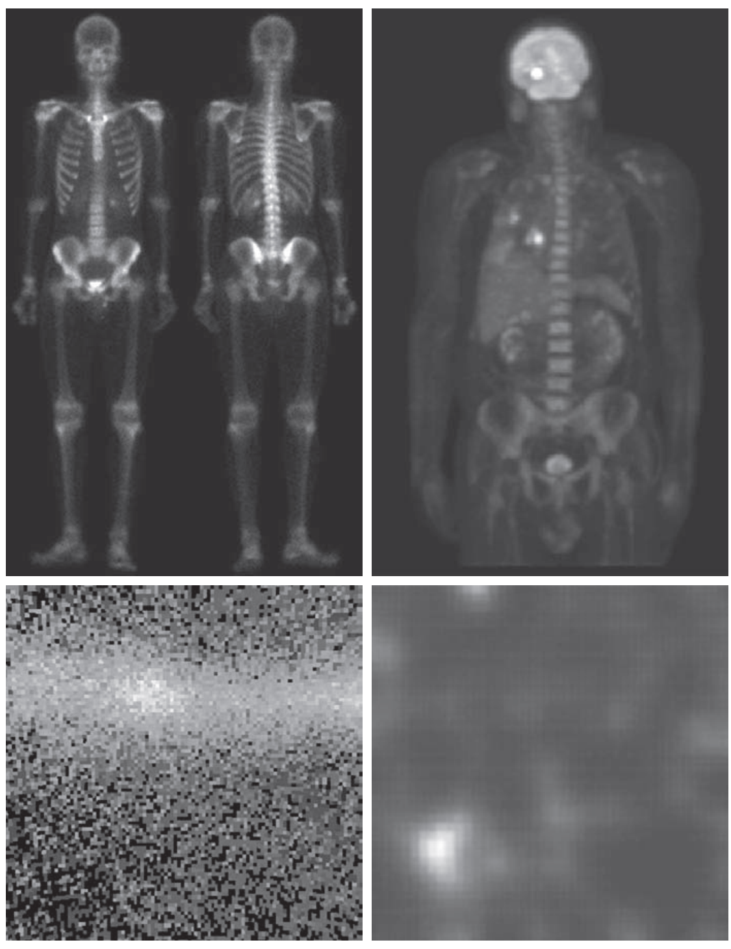
X-RAY IMAGING

Slide 14
Positron Emission Tomography (PET)
A positron emission tomography (PET) scan is an imaging test that can help reveal the metabolic or biochemical function of your tissues and organs. The PET scan uses a radioactive drug (tracer) to show both normal and abnormal metabolic activity.
PET scans may be used to evaluate organs and/or tissues for the presence of disease or other conditions. PET may also be used to evaluate the function of organs, such as the heart or brain. The most common use of PET is in the detection of cancer and the evaluation of cancer treatment.

Slide 15
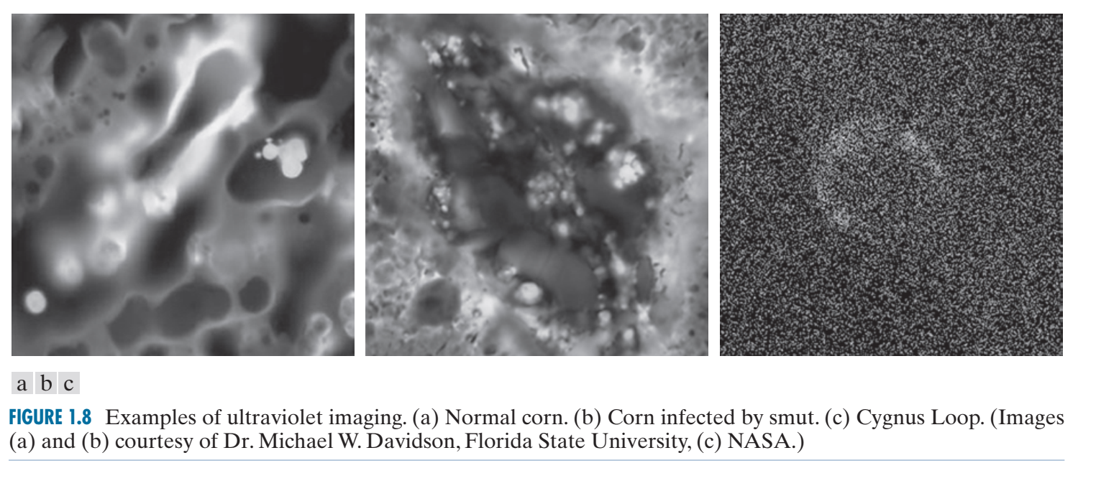
IMAGING IN THE ULTRAVIOLET BAND
Applications of ultraviolet “light” are varied. They include lithography, industrial inspection, microscopy, lasers, biological imaging, and astronomical observations.

Slide 16
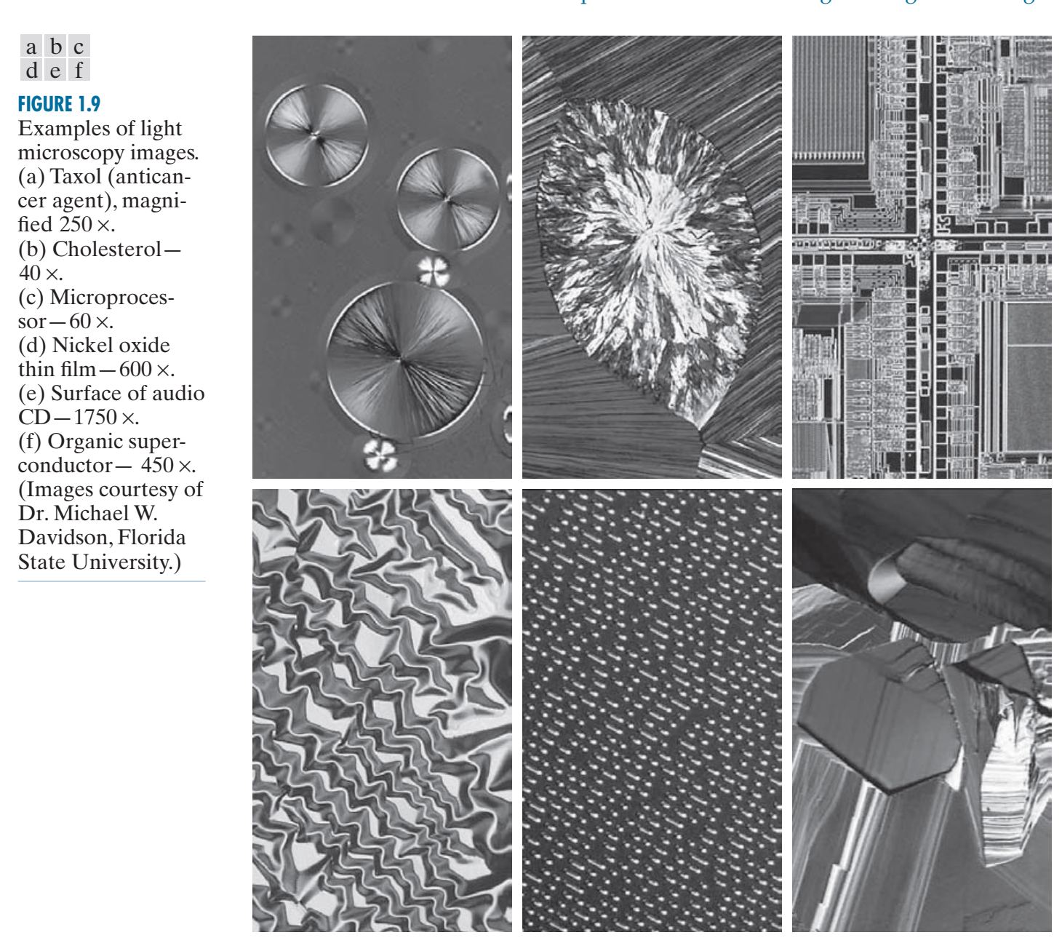
IMAGING IN THE VISIBLE AND INFRARED BANDS
Considering that the visual band of the electromagnetic spectrum is the most familiar in all our activities, it is not surprising that imaging in this band outweighs by far all the others in terms of breadth of application.

Slide 17
IMAGING IN THE MICROWAVE BAND
The principal application of imaging in the microwave band is radar. The unique feature of imaging radar is its ability to collect data over virtually any region at any time, regardless of weather or ambient lighting conditions. Some radar waves can penetrate clouds, and under certain conditions, can also see through vegetation, ice, and dry sand.

Slide 18
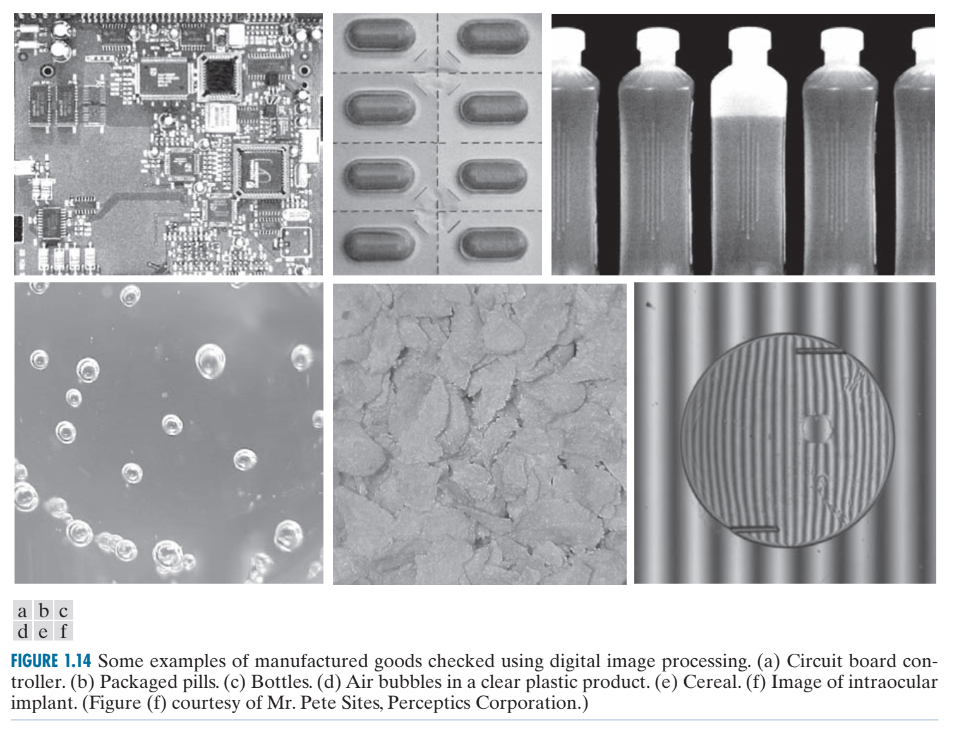

Slide 19
IMAGING IN THE RADIO BAND
As in the case of imaging at the other end of the spectrum (gamma rays), the major applications of imaging in the radio band are in medicine and astronomy. In medicine, radio waves are used in magnetic resonance imaging (MRI). patient in a powerful magnet and passes radio waves through the individual’s body in short pulses. Each pulse causes a responding pulse of radio waves to be emitted by the patient’s tissues. The location from which these signals originate and their strength are determined by a computer, which produces a two-dimensional image of a section of the patient. MRI can produce images in any plane.

Slide 20
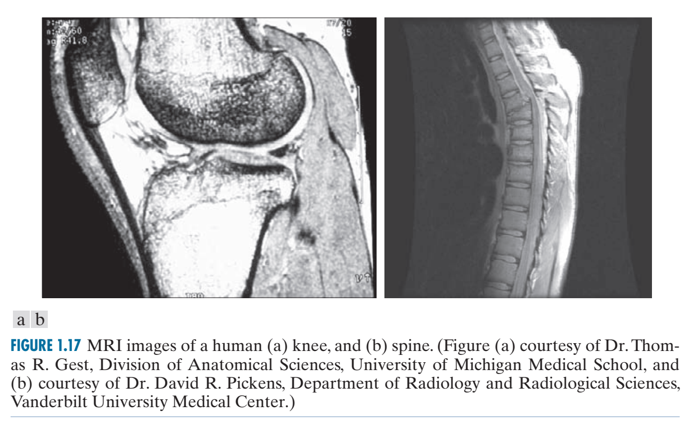

Slide 21
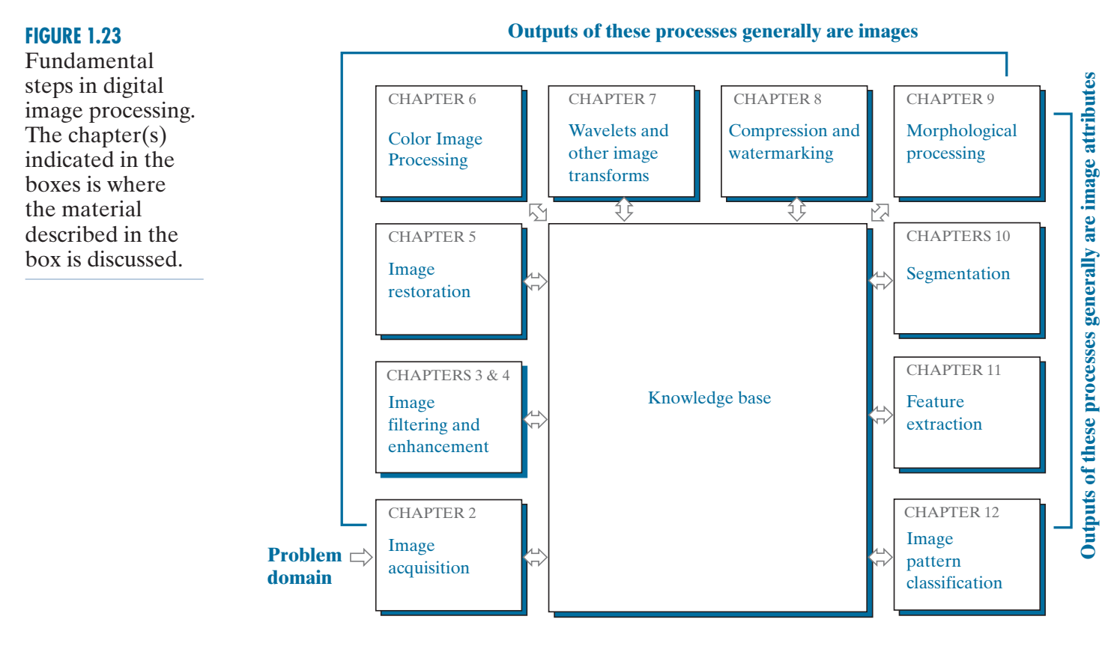
FUNDAMENTAL STEPS IN DIGITAL IMAGE PROCESSING

Slide 22
Image Acquisition
Image acquisition can be defined as the act of procuring an image from sources. This can be done via hardware systems such as cameras, encoders, sensors, etc. Irrefutably, it is the most crucial step in the MV workflow because an inaccurate image will render the entire workflow useless.

Slide 23
Image enhancement
Filtering
Low pass filters
High pass filters

Slide 24
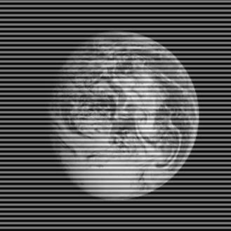
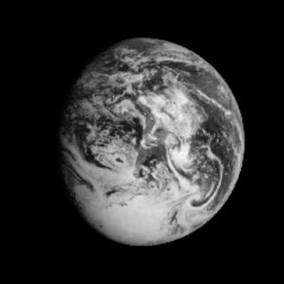
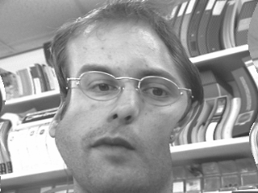
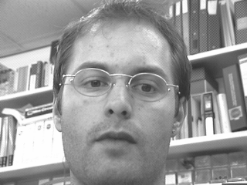
Image Restoration - Examples
Distorted image
Restored image
Geometrically distorted image
Restored image

Slide 25



Image Restoration – De-noising
Noisy images
Restored “Clean” images

Slide 26
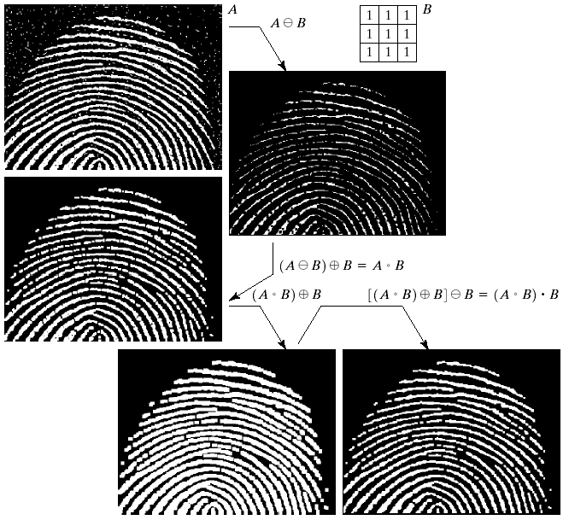
Key Stages in Digital Image Processing: Morphological Processing
Image Restoration
Morphological Processing
Image Enhancement
Segmentation
Image Acquisition
Object Recognition
Representation & Description
Problem Domain
Colour Image Processing
Image Compression

Slide 27
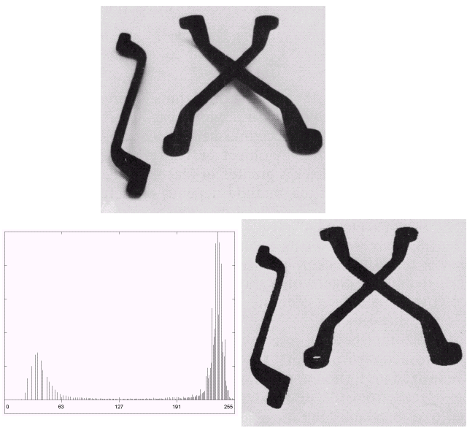

Key Stages in Digital Image Processing: Segmentation
Image Restoration
Morphological Processing
Image Enhancement
Segmentation
Image Acquisition
Object Recognition
Representation & Description
Problem Domain
Colour Image Processing
Image Compression

Slide 28
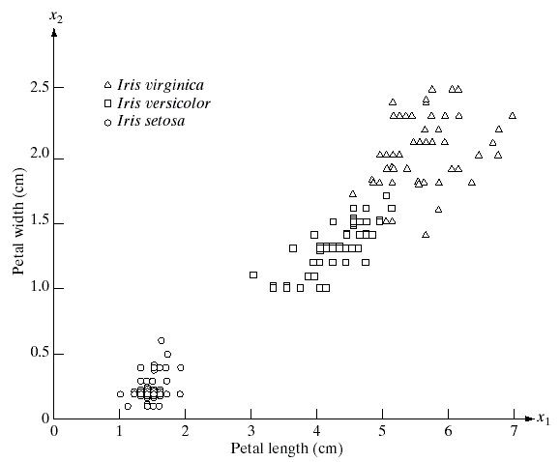
Key Stages in Digital Image Processing: Object Recognition
Image Restoration
Morphological Processing
Image Enhancement
Segmentation
Image Acquisition
Object Recognition
Representation & Description
Problem Domain
Colour Image Processing
Image Compression

Slide 29
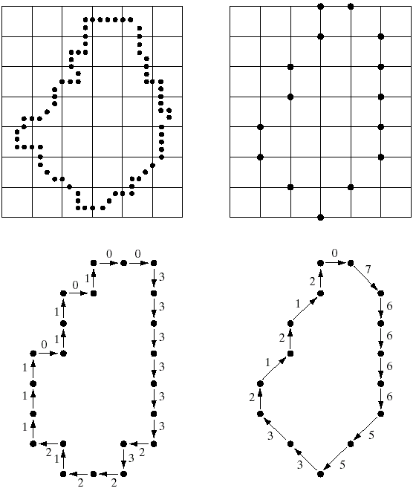
Key Stages in Digital Image Processing: Representation & Description
Image Restoration
Morphological Processing
Image Enhancement
Segmentation
Image Acquisition
Object Recognition
Representation & Description
Problem Domain
Colour Image Processing
Image Compression

Slide 30
Key Stages in Digital Image Processing: Representation & Description
Representation deals with the image's characteristics and regional properties. Description deals with extracting quantitative information that helps differentiate one class of objects from the other.

Slide 31
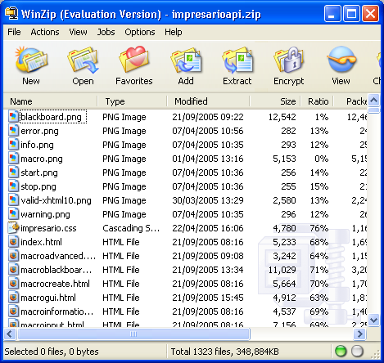
Key Stages in Digital Image Processing: Image Compression
Image Restoration
Morphological Processing
Image Enhancement
Segmentation
Image Acquisition
Object Recognition
Representation & Description
Problem Domain
Colour Image Processing
Image Compression

Slide 32



Image Compression
JPEG Compression)
Original image
JPEG2000 Compression

Slide 33
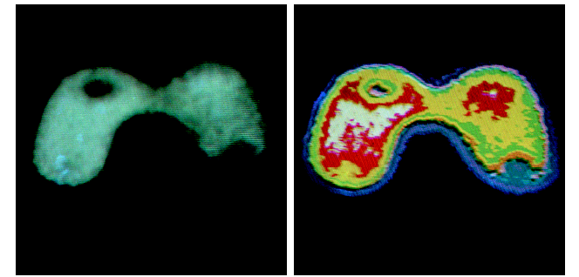
Key Stages in Digital Image Processing: Color Image Processing
Image Restoration
Morphological Processing
Image Enhancement
Segmentation
Image Acquisition
Object Recognition
Representation & Description
Problem Domain
Colour Image Processing
Image Compression

Slide 34
Color image processing
Color image processing is the analysis, transformation, and interpretation of visual data presented in color.

